Slide 1
Salary Data Analysis
Bolla Sushma Sri Durga
Source: https://www.kaggle.com/datasets/wardabilal/salary-prediction-dataset
Dataset: Salary_Data
Email: sushma362005@gmail.com
Phone: 9032842009
GitHub: https://github.com/Sushma-Bolla/BigDataAnalytics
LinkedIn: https://www.linkedin.com/in/bolla-sushma-sri-durga-5051482b2/

Slide 2
Introduction
This presentation provides a detailed analysis of employee salary data using PySpark.
It covers:
Dataset structure and description
Data exploration and processing
Key salary insights and trends
Recommendations based on findings

Slide 3
Dataset Description
Source: Salary_Data.csv
Columns:
    Age
    Gender
    Education_Level
    Job_Title
    Years_of_Experience
    Salary
Clean dataset with no missing values and diverse variation across gender, education, and roles.

Slide 4
Tools and Technologies Used
This project uses a range of tools and technologies for data analysis and processing:
Python – Used for performing data analysis and creating visualizations.
PySpark – Handles big data processing and executes distributed data operations efficiently.
Pandas & Matplotlib – Used for additional data manipulation and generating charts.
Jupyter Notebook – Development environment for writing and running PySpark code interactively.
CSV Dataset (Salary_Data.csv) – Contains details of 1,000 employees including age, gender, education, years of experience, and salary.
These technologies together enabled efficient salary data analysis and insights generation.

Slide 5
Data Exploration & Operations
Operations performed using PySpark:
Created Spark session and loaded dataset
Displayed schema and sample records
Counted total rows and columns
Selected salary-related attributes
Filtered high earners and experienced employees
Aggregated salary data (avg, min, max)
Calculated average salary by gender and education level

Slide 6
Methodology / Workflow
The project follows a structured approach to analyze salary data step by step:
Data Loading: Imported the Salary_Data.csv file into PySpark for analysis.
Data Cleaning and Schema Verification: Checked for missing values, verified column types, and ensured data quality.
Data Exploration and Filtering: Displayed sample records, selected relevant columns, and applied filters (e.g., salary > 50,000).
Aggregation and Calculations: Calculated average, minimum, and maximum salaries and grouped data by gender and education level.
Analysis of Salary Patterns: Analyzed how salary varies based on experience, age, gender, and education.
Insights and Recommendations: Summarized key findings and provided suggestions to improve workforce and salary planning.
This workflow ensures a complete understanding of salary distribution and the factors influencing it.

Slide 7
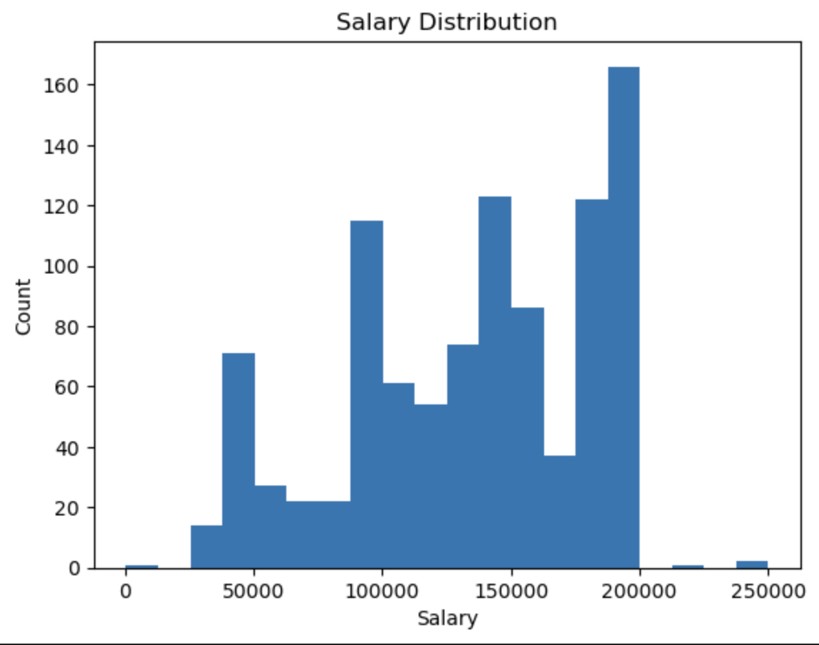
Salary Distribution Insights
Salaries show significant variation across roles and experience levels.
Salary distribution closely aligns with years of experience, with higher salaries more common among senior professionals.
Caption

Slide 8
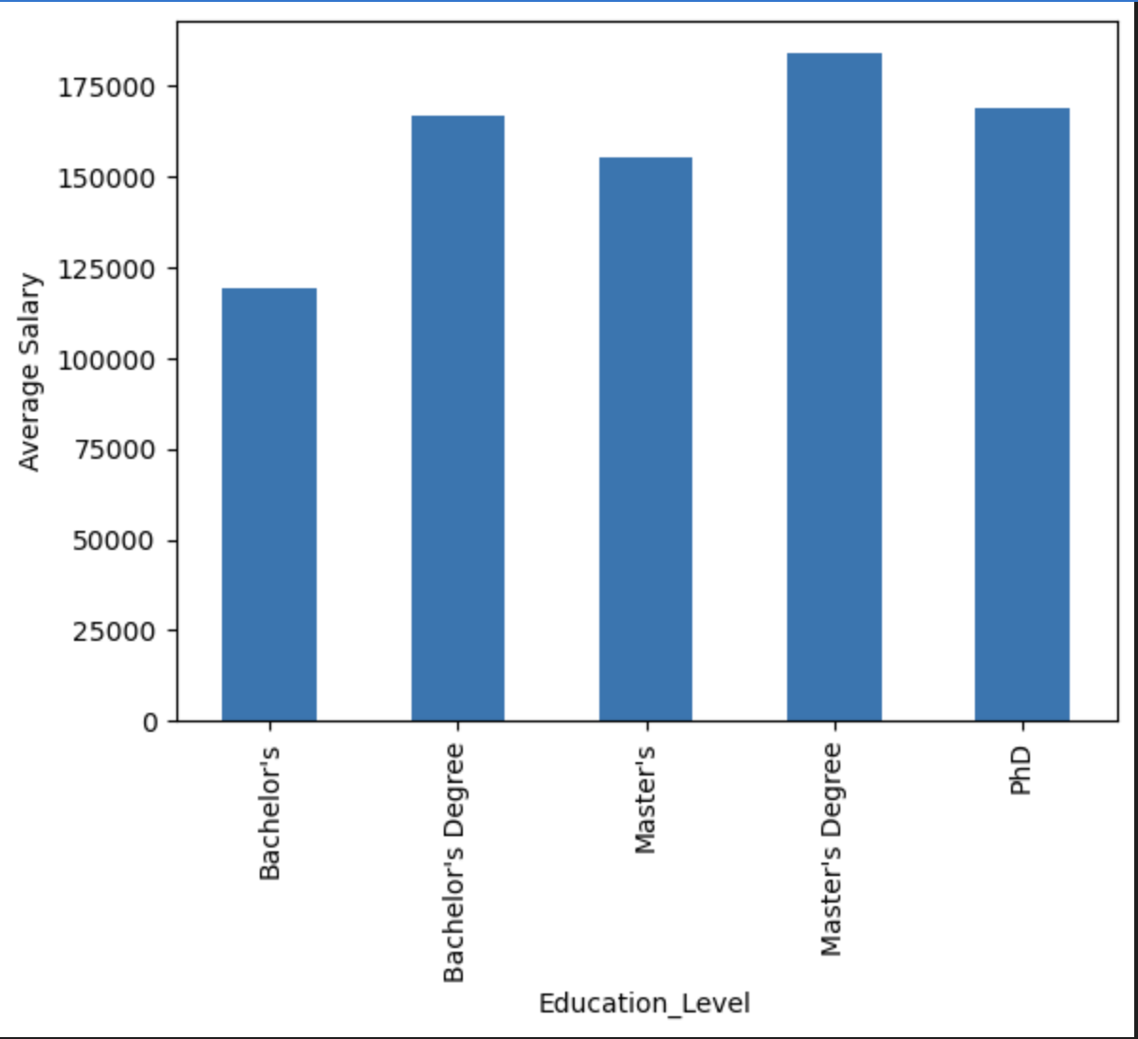
Education-Level Salary Insights
Employees with higher education levels earn higher salaries.
Postgraduates and specialized degree holders significantly outperform undergraduates.
Education has a strong positive impact on salary growth.

Slide 9
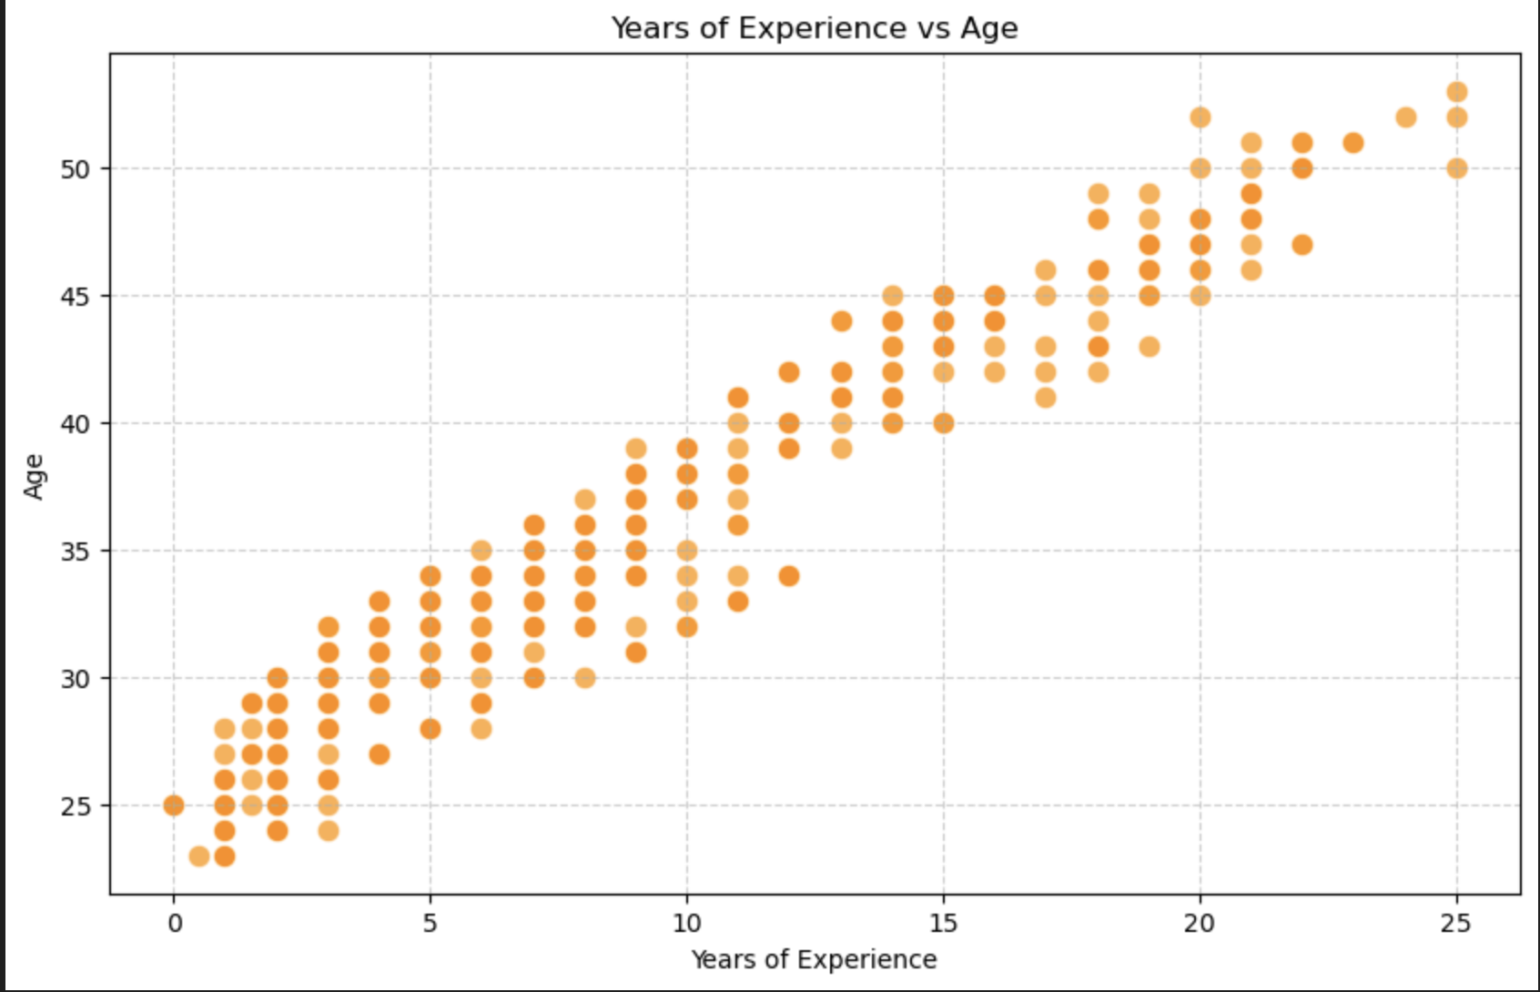
Years of Experience vs Age Insights
As age increases, years of experience also increase consistently.
Most employees start their careers in their early 20s and gain experience steadily over time.
This clear upward trend indicates that age and experience grow proportionally, and both are important contributors to salary growth.
Caption

Slide 10
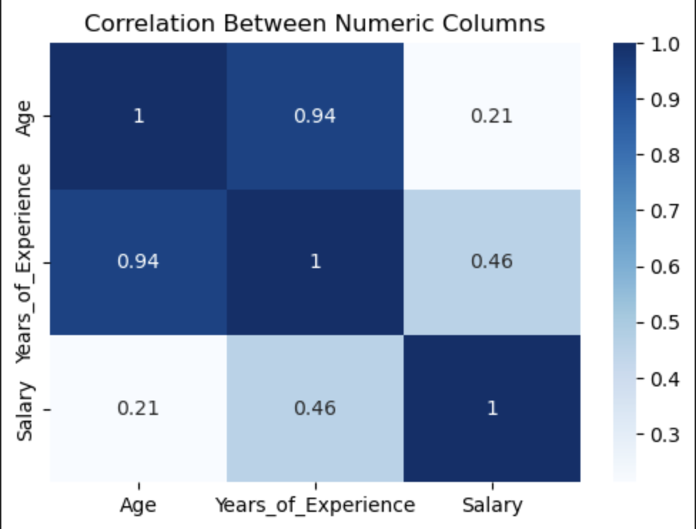
Correlation Between Numeric Columns
Age and Years of Experience show a very strong positive correlation of 0.94, meaning they increase together. Years of Experience and Salary have a moderate positive correlation of 0.46, showing that higher experience generally leads to higher salaries.
Age and Salary have a weaker correlation of 0.21, indicating that age alone is not a major factor — experience plays a more significant role in influencing salary.
Caption

Slide 11
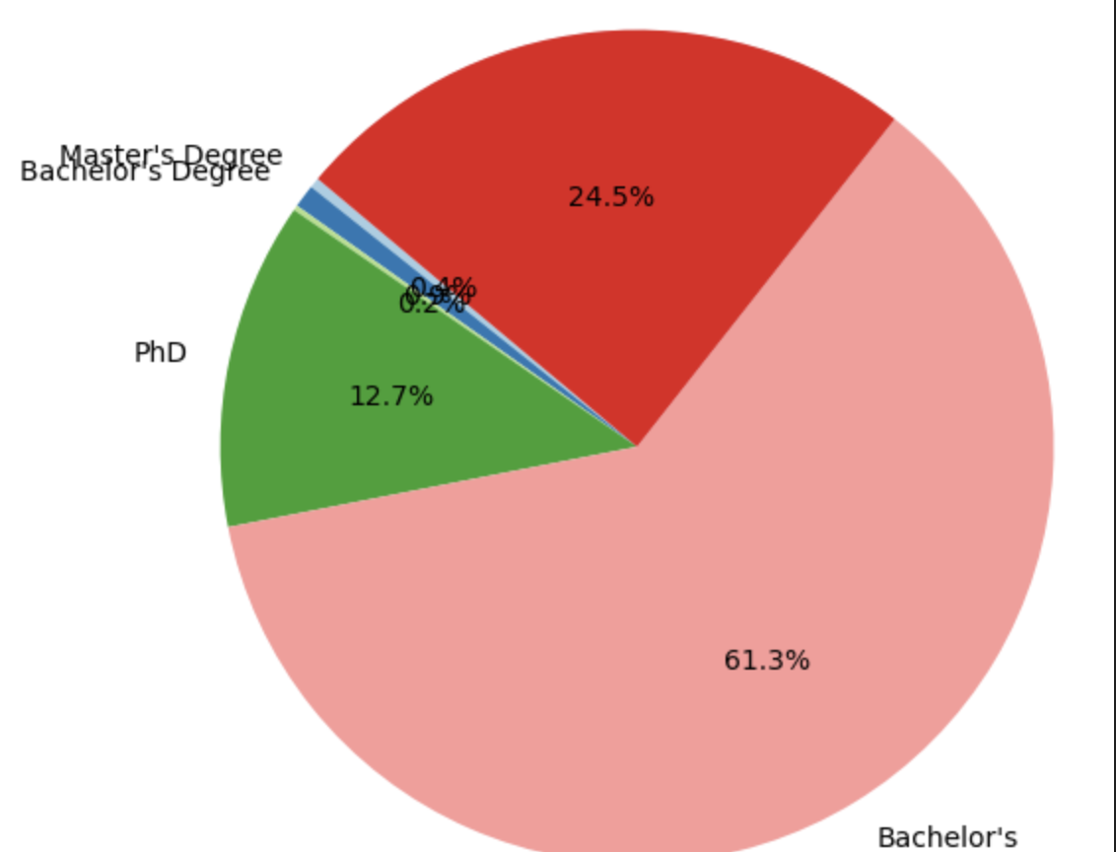
Distribution of Employees by Education Level
Most employees (61.3%) have a Bachelor’s degree, forming the largest group.
24.5% of employees hold a Master’s degree, showing many have higher education.
This shows that education level affects workforce roles and salary levels.
Caption

Slide 12
Key Findings
Salary increases with years of experience and age, showing a clear growth pattern as employees gain more skills and seniority.
Higher education levels lead to higher salaries — employees with Master’s and PhDs earn more than those with Bachelor’s degrees.
Male employees have slightly higher average salaries than female employees, indicating a small gender pay gap.
Most employees earn mid-level salaries, with only a few high-salary outliers representing senior or specialized positions.
Bachelor’s degree holders make up the largest part of the workforce (61.3%), followed by Master’s and PhD holders.
The strong correlation (0.94) between age and experience confirms that both factors play a major role in salary growth.

Slide 13
Recommendations
Conduct deeper analysis into gender-based salary gaps.
Align compensation with education and experience levels.
Implement skill development programs to improve salary outcomes.
Build predictive models for salary forecasting and workforce planning.

Slide 14
Conclusion
Salary is strongly influenced by experience, education level, and job role.
The analysis confirms that highly qualified and experienced employees earn more.
These insights can guide compensation strategy, workforce planning, and predictive analytics.

